Slide 1
Test automation course
Lesson 2

Slide 2

Table of contents
UML notations.
Basic data types.
Access modifiers.
Non-access modifiers.
Java constructor.
This keyword in Java.
Void keyword in Java.
Return keyword in Java.
Creation of class instances (objects).

Slide 3
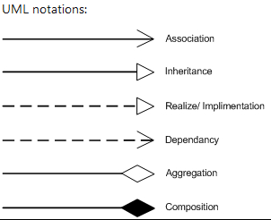
1. UML notations.
Class diagrams are widely used to describe the types of objects in a system and their relationships. Class diagrams model class structure and contents using design elements such as classes, packages and objects. Class diagrams describe three different perspectives when designing a system, conceptual, specification, and implementation. These perspectives become evident as the diagram is created and help solidify the design.
The Class diagrams, physical data models, along with the system overview diagram are in my opinion the most important diagrams that suite the current day rapid application development requirements.

Slide 4
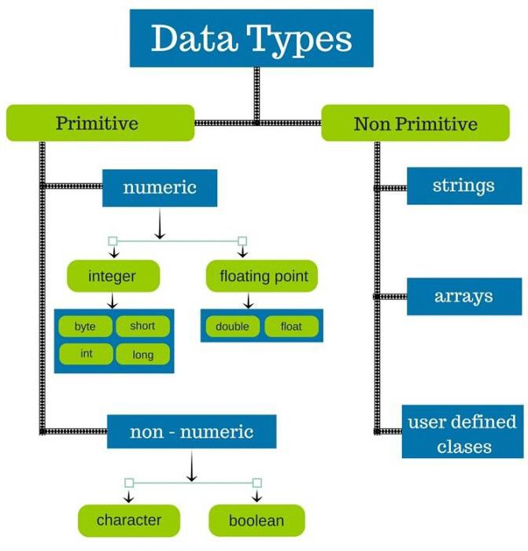
2. Basic data types.
There are two data types available
in Java:
Primitive Data Types
1. byte
2. short
3. int
4. long
5. float
6. double
7. boolean
8. char
Reference/Object Data Types

Slide 5
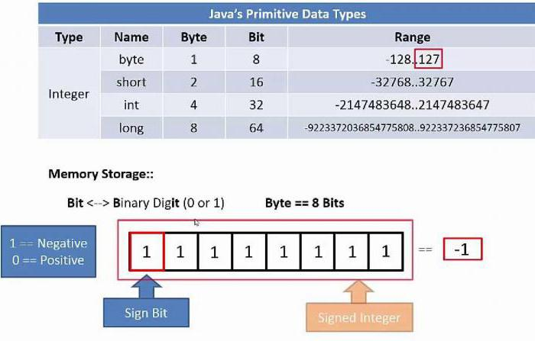
2. Basic data types.
1. byte
Byte data type is an 8-bit signed two's complement
integer
Minimum value is -128 (-2^7)
Maximum value is 127 (inclusive)(2^7 -1)
Default value is 0
Byte data type is used to save space in large arrays,
Mainly in place of integers, since a byte is four times
smaller than an integer.
Example: byte a = 100, byte b = -50
2. short
Short data type is a 16-bit signed two's complement integer
Minimum value is -32,768 (-2^15)
Maximum value is 32,767 (inclusive) (2^15 -1)
Short data type can also be used to save memory as byte data type. A short is 2 times smaller than an integer
Default value is 0.
Example: short s = 10000, short r = -20000

Slide 6
2. Basic data types.
3. int
Int data type is a 32-bit signed two's complement integer.
Minimum value is - 2,147,483,648 (-2^31)
Maximum value is 2,147,483,647(inclusive) (2^31 -1)
Integer is generally used as the default data type for integral values unless there is a concern about memory.
The default value is 0
Example: int a = 100000, int b = -200000
4. long
Long data type is a 64-bit signed two's complement integer
Minimum value is -9,223,372,036,854,775,808(-2^63)
Maximum value is 9,223,372,036,854,775,807 (inclusive)(2^63 -1)
This type is used when a wider range than int is needed
Default value is 0L
Example: long a = 100000L, long b = -200000L
5. float
Float data type is a single-precision 32-bit IEEE 754 floating point
Float is mainly used to save memory in large arrays of floating point numbers
Default value is 0.0f
Float data type is never used for precise values such as currency
Example: float f1 = 234.5f

Slide 7
2. Basic data types.
6. double
double data type is a double-precision 64-bit IEEE 754 floating point
This data type is generally used as the default data type for decimal values, generally the default choice
Double data type should never be used for precise values such as currency
Default value is 0.0d
Example: double d1 = 123.4
7. boolean
boolean data type represents one bit of information
There are only two possible values: true and false
This data type is used for simple flags that track true/false conditions
Default value is false
Example: boolean one = true
8. char
char data type is a single 16-bit Unicode character
Minimum value is '\u0000' (or 0)
Maximum value is '\uffff' (or 65,535 inclusive)
Char data type is used to store any character
Example: char letterA = 'A'

Slide 8
2. Basic data types.
Reference Datatypes
Reference variables are created using defined constructors of the classes. They are used to access objects. These variables are declared to be of a specific type that cannot be changed. For example, Employee, Puppy, etc.
Class objects and various type of array variables come under reference datatype.
Default value of any reference variable is null.
A reference variable can be used to refer any object of the declared type or any compatible type.
Example: Animal animal = new Animal("giraffe");

Slide 9
2. Basic data types.
Java language supports few special escape sequences for String and char literals as well.
Notation | Character represented
\n | Newline (0x0a)
\r | Carriage return (0x0d)
\f | Formfeed (0x0c)
\b | Backspace (0x08)
\s | Space (0x20)
\t | tab
\" | Double quote
\' | Single quote
\\ | backslash
\ddd | Octal character (ddd)
\uxxxx | Hexadecimal UNICODE character (xxxx)

Slide 10
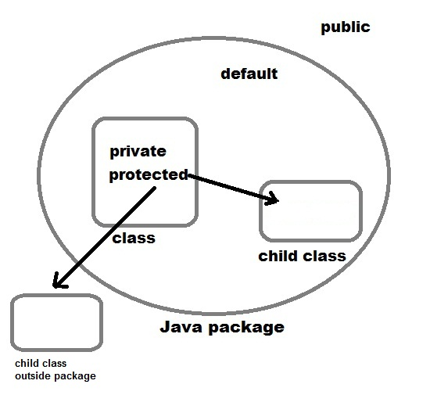
3. Access modifiers.
Java provides a number of access modifiers to set access levels for classes, variables, methods, and constructors. The four access levels are −
Visible to the package, the default.
No modifiers are needed.
Visible to the class only (private).
Visible to the world (public).
Visible to the package and all
subclasses (protected).

Slide 11

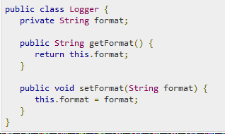
3. Access modifiers.
Default Access Modifier - No Keyword
Default access modifier means we do not explicitly declare an access
modifier for a class, field, method, etc.
A variable or method declared without any access control modifier is
available to any other class in the same package. The fields in an interface are
implicitly public static final and the methods in an interface are by default public.
Private Access Modifier - Private
Methods, variables, and constructors that are declared private can only
be accessed within the declared class itself.
Private access modifier is the most restrictive access level. Class and interfaces
cannot be private.
Variables that are declared private can be accessed outside the class, if public
getter methods are present in the class.
Using the private modifier is the main way that an object encapsulates itself and
hides data from the outside world.

Slide 12

3. Access modifiers.
Public Access Modifier - Public
A class, method, constructor, interface, etc.
declared public can be accessed from any other
class. Therefore, fields, methods, blocks declared
inside a public class can be accessed from any class belonging to the Java Universe.
However, if the public class we are trying to access is in a different package, then the public class still needs to be imported. Because of class inheritance, all public methods and variables of a class are inherited by its subclasses.

Slide 13
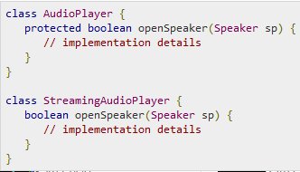
3. Access modifiers.
Protected Access Modifier - Protected
Variables, methods, and constructors, which are
declared protected in a superclass can be accessed
only by the subclasses in other package or any class
within the package of the protected members' class.
The protected access modifier cannot be applied to
class and interfaces. Methods, fields can be declared protected, however methods and fields in a interface cannot be declared protected.
Protected access gives the subclass a chance to use the helper method or variable, while preventing a nonrelated class from trying to use it.

Slide 14
4. Non-access modifiers.
Java provides a number of non-access modifiers to achieve many other functionalities.
The static modifier for creating class methods and variables.
The final modifier for finalizing the implementations of classes, methods, and variables.
The abstract modifier for creating abstract classes and methods.
The synchronized and volatile modifiers, which are used for threads

Slide 15
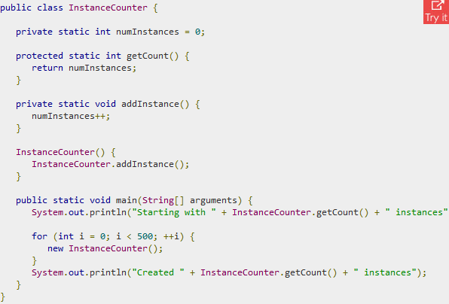
4. Non-access modifiers.
Static Variables
The static keyword is used to create variables that will
exist independently of any instances created for the class.
Only one copy of the static variable exists regardless of the
number of instances of the class.
Static variables are also known as
class variables. Local variables cannot be declared static.
Static Methods
The static keyword is used to create methods that will
exist independently of any instances created for
the class.
Static methods do not use any instance variables of any
object of the class they are defined in. Static methods
take all the data from parameters and compute something
from those parameters, with no reference to variables.
Class variables and methods can be accessed
using the class name followed by a dot and the name of the variable or method.

Slide 16
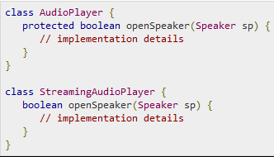
4. Non-access modifiers.
The Final Modifier
Final Variables
A final variable can be explicitly initialized
only once. A reference variable declared final
can never be reassigned to refer to an different
object.
However, the data within the object can be changed. So, the state of the object can be changed but not the reference.
With variables, the final modifier often is used with static to make the constant a class variable.

Slide 17

4. Non-access modifiers.
The Final Modifier
Final Methods
A final method cannot be overridden by any subclasses. As mentioned previously, the final modifier prevents a method from being modified in a subclass.
The main intention of making a method final would be that the content of the method should not be changed by any outsider.

Slide 18

4. Non-access modifiers.
The Final Modifier
Final Classes
The main purpose of using a class being declared as final is to prevent the class from being subclassed. If a class is marked as final then no class can inherit any feature from the final class.

Slide 19
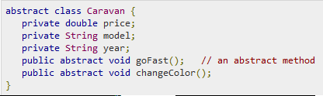
4. Non-access modifiers.
The abstract Modifier
Abstract Class
An abstract class can never be instantiated.
If a class is declared as abstract then the sole
purpose is for the class to be extended.
A class cannot be both abstract and final (since a final class cannot be extended). If a class contains abstract methods then the class should be declared abstract. Otherwise, a compile error will be thrown.
An abstract class may contain both abstract methods as well normal methods.

Slide 20
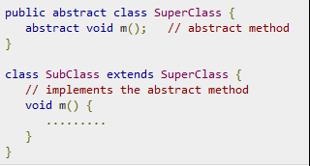
4. Non-access modifiers.
The abstract Modifier
Abstract Methods
An abstract method is a method declared without
any implementation. The methods body
(implementation) is provided by the subclass. Abstract
methods can never be final or strict.
Any class that extends an abstract class must implement all the abstract methods of the super class, unless the subclass is also an abstract class.
If a class contains one or more abstract methods, then the class must be declared abstract. An abstract class does not need to contain abstract methods.
The abstract method ends with a semicolon. Example: public abstract sample();

Slide 21

4. Non-access modifiers.
The Synchronized Modifier
The synchronized keyword used to indicate that a method can be accessed by only one thread at a time. The synchronized modifier can be applied with any of the four access level modifiers.

Slide 22

4. Non-access modifiers.
The Transient Modifier
An instance variable is marked transient to indicate the JVM to skip the particular variable when serializing the object containing it.
This modifier is included in the statement that creates the variable, preceding the class or data type of the variable.

Slide 23
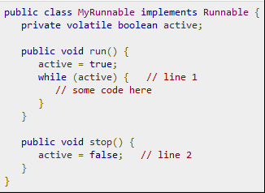
4. Non-access modifiers.
The Volatile Modifier
The volatile modifier is used to let the JVM
know that a thread accessing the variable must
always merge its own private copy of the variable
with the master copy in the memory.
Accessing a volatile variable synchronizes all
the cached copied of the variables in the main memory. Volatile can only be applied to instance variables, which are of type object or private. A volatile object reference can be null.

Slide 24
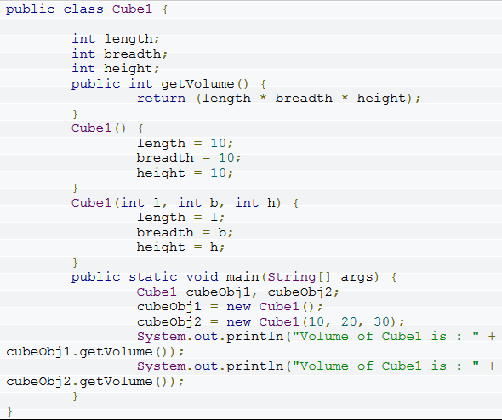
5. Java constructor.
A java constructor has the same name as the name of the class to which it belongs. Constructor’s syntax does not include a return type, since constructors never return a value.
Constructors may include parameters of various types. When the constructor is invoked using the new operator, the types must match those that are specified in the constructor definition.
Java provides a default constructor which takes no arguments and performs no special actions or initializations, when no explicit constructors are provided.
The only action taken by the implicit default constructor is to call the superclass constructor using the super() call. Constructor arguments provide you with a way to provide parameters for the initialization of an object.
Below is an example of a cube class containing 2 constructors. (one default and one parameterized constructor).

Slide 25
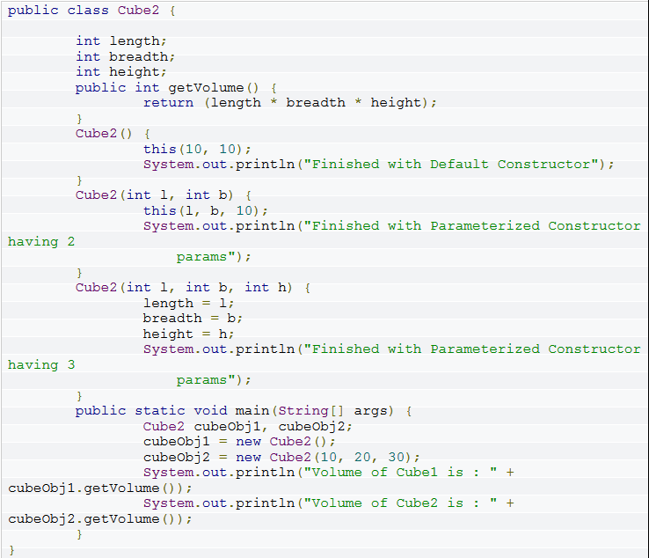
5. Java constructor.
JAVA OVERLOADED CONSTRUCTORS
Like methods, constructors can also be overloaded. Since the constructors in a class all have the same name as the class, their signatures are differentiated by their parameter lists. The above example shows that the Cube1 constructor is overloaded, one being the default constructor and the other being a parameterized constructor.
It is possible to use this() construct, to implement local chaining of constructors in a class. The this() call in a constructor invokes an other constructor with the corresponding parameter list within the same class. Calling the default constructor to create a Cube object results in the second and third parameterized constructors being called as well. Java requires that any this() call must occur as the first statement in a constructor.
Below is an example of a cube class containing 3 constructors which demostrates the this() method in Constructors context.

Slide 26
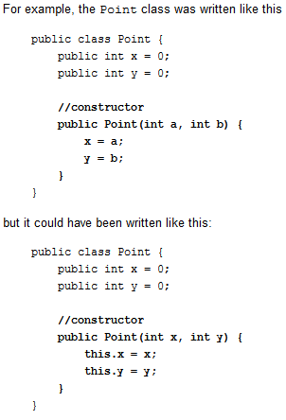
6. This keyword in Java.
Within an instance method or a constructor, this is a reference to the current object — the object whose method or constructor is being called. You can refer to any member of the current object from within an instance method or a constructor by using this.
Using this with a Field
The most common reason for using the this keyword is because a field is shadowed by a method or constructor parameter.
Each argument to the constructor shadows one of the object's fields — inside the constructor x is a local copy of the constructor's first argument. To refer to the Point field x, the constructor must use this.x

Slide 27
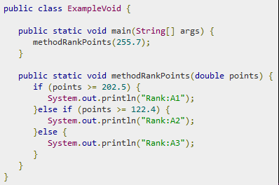
7. Void keyword in Java.
The void keyword allows us to create
methods which do not return a value.
Here, in the following example we're
considering a void method
methodRankPoints.
This method is a void method, which
does not return any value

Slide 28

8. Return keyword in Java.
A method returns to the code that invoked it when it
completes all the statements in the method,
reaches a return statement, or
throws an exception (covered later),
whichever occurs first.
You declare a method's return type in its method declaration. Within the body of the method, you use the return statement to return the value.
Any method declared void doesn't return a value. It does not need to contain a return statement, but it may do so. In such a case, a return statement can be used to branch out of a control flow block and exit the method and is simply used like this:
return;
If you try to return a value from a method that is declared void, you will get a compiler error.

Slide 29
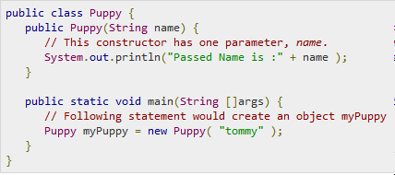
9. Creation of class instances (objects).
As mentioned previously, a class provides the blueprints for objects. So basically, an object is created from a class. In Java, the new keyword is used to create new objects.
There are three steps when creating an object from a class −
Declaration − A variable declaration with a variable name with an object type.
Instantiation − The 'new' keyword is used to create the object.
Initialization − The 'new' keyword is followed by a call to a constructor. This call initializes the new object.

